Slide 1

The peacock reach your dream

Slide 2

Why this brand name ?
Peacocks are distinguished from other creatures in that during the mating season, the male spreads his tail (showcasing his abilities), and the female chooses the male with the longest tail and the most eye patterns, as this is an indication of his health. This is a perfect example of the relationship between every actor and a production company or casting office, where the actor presents his abilities and tries to highlight his uniqueness in the best possible way (the male), until the casting office (the (female) selects him to perform the artistic work
This name reflects a sense of elegance and distinction, which aligns with the brand, as it is unique of its kind in this field in Egypt and the Arab world.

Slide 3
The core idea of the brand
We aim to make the experience for actors who are looking for an opportunity to appear on screen in a simple and professional way

Slide 4
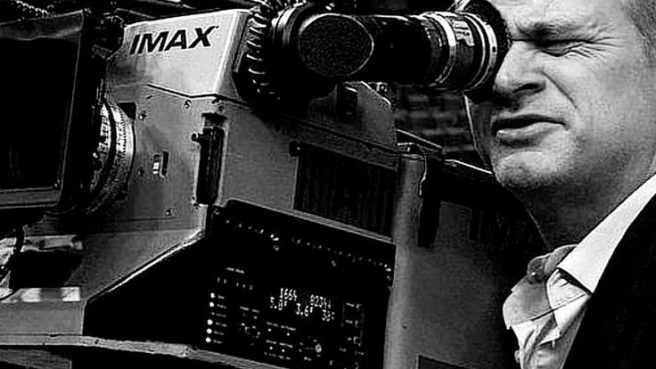
Brand message&values
We build healthy relationships between every actor and production company to provide continuous job opportunities in this field.

Slide 5
The problems
The idea of casting offices and the constant crowding there often creates a fertile environment for problems, especially during busy drama seasons like the period before Ramadan. Crowding not only causes difficulty in breathing but has also led in real cases to unfortunate incidents.
Fainting and suffocation cases
These incidents are the most common. Casting offices are often located in residential apartments or small spaces not equipped to accommodate hundreds of people at once.
Fights and physical altercations
Waiting for long hours under the sun or in narrow corridors increases stress levels, which can lead to conflicts.
Selling forms
Some unprofessional offices take advantage of large numbers of applicants by selling application forms.

Slide 6
The project solves
And because of all these problems, we decided to create the Peacock Brand.
The brand is an online casting platform where you can upload all your data — including your name, age, photos, showreel, voice sample, and appearance. Using artificial intelligence, all submitted data is filtered according to the needs of each production company and each artistic project, and the required talent is selected electronically.
This way, we avoid the crowding, fights, and stress of casting offices and protect against fraud through selling forms.
In this way, you can reach your dream in a simple and professional way.

Slide 7
Target audience
We target actors of all ages who want to work in the media field but can’t find an opportunity or a way to be seen, and we’re trying to create the easiest path for them to achieve that

Slide 8
Brand personality & tone
We derive the brand’s personality from its name, The Peacock, which conveys a sense of luxury, elegance, distinction, and modernity

Slide 9
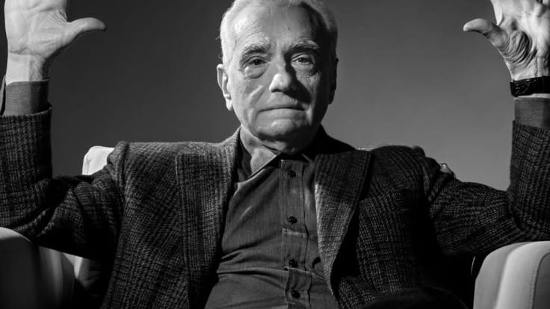
Unique Selling Proposition (USP)
The first electronic casting platform in Egypt and the Arab world, designed to simplify all the work of production companies and actors.

Slide 10

Buisness model
Revenue Streams (How you make money)
Subscription Model (SaaS):
For Talent (Freemium): * Basic: Free profile with limited uploads.
Pro: HD Showreels, priority in search results, and AI-driven performance insights (e.g., profile strength analysis).
For Production Houses/Casting Directors: Monthly or annual tiers to access the smart database and advanced filtering tools.
Pay-per-Project: A one-time fee for independent filmmakers or agencies to host a specific casting call and use the platform’s management tools for that project only.
Value-Added Services (VAS): * Professional headshot sessions, acting coaching, and "Profile Optimization" services.
Commission (Optional): A small percentage or fixed "finder's fee" upon the talent’s first successful contract via the platform.

Slide 11

Cost Structure (Your Expenses)
R&D and Tech Development: Building the AI engine, cloud storage for high-res videos, and maintaining a secure database.
Marketing & Acquisition: Targeting high-profile directors to bring "prestige" to the platform, which naturally attracts talent.
Operational Costs: Legal compliance (GDPR for data privacy) and customer support.

Slide 12
Core AI Features (The Competitive Edge)
Smart Matching Algorithm: Instead of manual scrolling, the system suggests the top 10 candidates based on physical traits, skills, and past experience.
AI Video/Voice Analysis: * Analyzing vocal tone (e.g., deep, energetic, husky) for voice-over roles.
Detecting facial expressions and "emotional range" in uploaded audition clips.
Automated Scheduling: A digital "waiting room" to manage physical auditions and eliminate crowding.
Reliability Rating: A reputation score for talent based on their punctuality and professionalism on set (feedback from previous directors).

Slide 13
Key Partners
Actors' Guilds & Unions: To ensure legitimacy and protect talent rights.
Talent Agencies: Providing them with a "Dashboard" to manage their entire roster efficiently.
Film Schools: To capture "fresh blood" and upcoming talent early on.

Slide 14
Go-to-Market Strategy
Phase 1 (Commercials): Focus on the TVC (TV Commercial) and Digital Ads market; it’s fast-paced and needs high turnover.
Phase 2 (Exclusive Pilots): Partner with a renowned Casting Director to run one major series or movie exclusively through your platform.
Phase 3 (Regional Expansion): Scale to high-demand markets like Saudi Arabia (NEOM/Riyadh Season) and the UAE.

Slide 15
competitors
المنصة | الفئة المستهدفة | الوظيفة الأساسية | استخدام الذكاء الاصطناعي | القيمة المضافة | نقاط الضعف
Cast Me Now (AI Submission Assistant) | ممثلين | التقديم التلقائي للأدوار المناسبة | تحليل بروفايل – صور – شوريل – Auto Apply | توفير وقت التقديم وزيادة فرص القبول | يعتمد على منصات كاستينج خارجية
Cast Me Now for Production & Directors | مخرجين وشركات إنتاج | مطابقة الممثلين مع وصف الدور | تحليل الدور + Fit Score | تسريع البحث وتقليل الفرز اليدوي | يحتاج قاعدة بيانات ممثلين قوية
Casting AI Agent | فرق كاستينج | مساعد ذكي لعملية الكاستينج | تحليل Headshots وفيديوهات | تنظيم وفرز أسرع للممثلين | لا يغطي التقديم أو النشر
Traditional Casting Platforms | ممثلين ومخرجين | نشر أدوار وتقديم يدوي | محدود أو بدون AI | انتشار واسع | وقت طويل ومجهود كبير

Slide 16

Competitors' Visual Identities

Slide 17
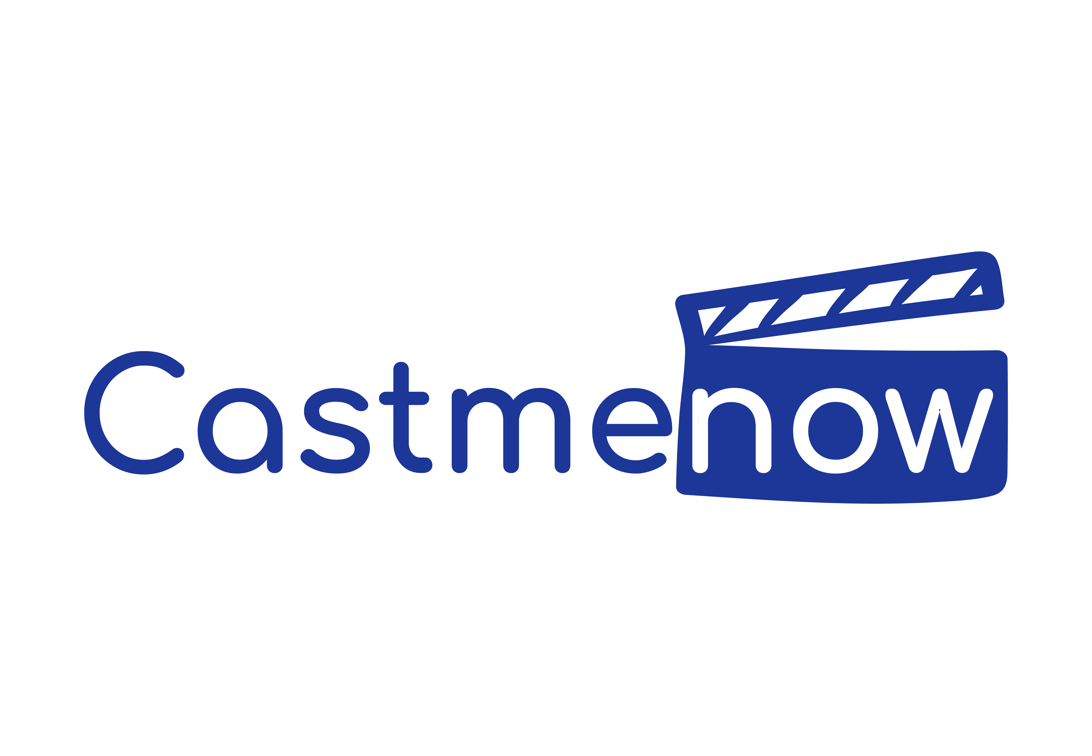
Cast me now (combination mark)
his brand’s logo draws inspiration from the iconic clapperboard used in filmmaking. A specific shade of blue was chosen to evoke a sense of tranquility and trust, reflecting the calm and professional casting experience provided. The clapperboard is purposefully depicted in its open position, as if filming is about to begin—perfectly aligning with the brand’s name: Cast Me (Now)

Slide 18

Cast it systems (combination mark)
"This design is inspired by the letter 'C' from the word 'Cast', reimagined as a searchlight beaming toward the sky to pierce the darkness and unveil new opportunities. The color purple was specifically selected for its ability to reflect creativity and imagination, while simultaneously conveying a sense of luxury and excellence."

Slide 19

Backstage (abstract mark)
"This design is inspired by the letter 'b' in the word 'Backstage', cleverly utilizing negative space to form the character. At the same time, the structure of the letter 'b' is designed to resemble theatrical wings or a backstage area, creating a perfect visual harmony with the brand name: Backstage."

Slide 20
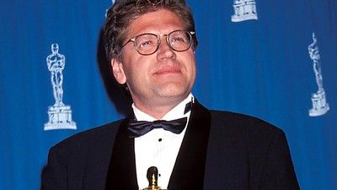
Conceptual Customer Experience
We offer an experience distinguished by simplicity, professionalism, elegance, and progress

Slide 21
Thank you
Team members
STEVEN REMON
SILVIA MILAD
RAWAN REKAPY
RAMZY

